Slide 1

Aditya Case Study Assessment :
CUSTOMER RETENTION CASE STUDY

Slide 2

Case study on Customer Retention
Business objective
A Spanish Bank has been collecting the data on multiple facets of customer behavior-active or inactive at beginning and end of a given period, cross buying of different products as well as demographics.
Understanding of the problem
To understand the customer behavior particularly their propensity to churn.
Both the demographics and cross buying of products are considered.
Activity status- At the start of 6 months and at end of 6 months.

Slide 3
Approach
Exploratory Data Analysis :
Profiles are in the category of people who turn from Active to Inactive and
vice versa.
This helps us to find the profiles who can improve our customer base for the
Firm.
At the end of 6 months the profiles which changes from Inactive to Active status.
The approach that solves the business problem starts with the data collection and Quality check, followed by detecting the patterns in the data with the help of data visualization and EDD development.
Interpreting Results :
Interpreting the results and find out key performance indicators

Slide 4
Analysis/Modeling Methodology
Data Preparation and & EDA
The dataset of Spanish bank consists of 10 variables and in that 3 variables are categorical and remaining all are numerical variables.
There is no missing variables in the dataset.
There are 1191 duplicate records.
Univariate distribution is performed on relevant variables.
Bivariate distributions is plotted between all meaning full variables.
The dataset has outliers for variables for age , segment , Gross income , Number of Products.
Based on the outlier of age variable we can say that they are more number of people having age 20 to 40.
From the analysis of outliers we can say that females are more compared to males.

Slide 5
Extended Data Dictionary (EDD)
 | Variable Type | Min | Pc 5% | Pc 25% | Pc 50% | Mean | Pc 75% | Max | No.of Missing values | No.of Unique values
Gender | Object | - | - | - | - | - | - | - | 0 | 2
Age | Float 64 | 2.00 | 21.00 | 25.00 | 40.00 | 40.07 | 51.0 | 112 | 0 | 110
Gross Income | Float 64 | 2.33 | 4.01 | 6.86 | 1.01 | 134269(Rs) | 1.5 | 2.88 | 0 | 49994
Segment | Object | - | - | - | - | - | - | - | 0 | 3
Number of credit cards | Float 64 | 0.00 | 0.00 | 0.00 | 0.00 | 0.05 | 0.00 | 1.00 | 0 | 2
Active-Inactive-Start | Object | - | - | - | - | - | - | - | 0 | 2
Active-Inactive-End | Float 64 | 0.00 | 0.00 | 0.00 | 0.00 | 0.46 | 1.00 | 1.00 | 0 | 2
Number of Products | Float 64 | 0.00 | 0.00 | 1.00 | 1.00 | 1.53 | 2.00 | 13.0 | 0 | 14
Number of Loans | Float 64 | 0.00 | 0.00 | 0.00 | 0.00 | 0.009 |  | 1.00 | 0 | 2
Duration | Float 64 | 366.00 | 607 | 1118 | 2048 | 2914 | 4691 | 7909 | 0 | 5677

Slide 6
Key Findings From Extended Data Dictionary (EDD)
There are more number of individuals in the segment Variable.
The top most people in gender variable is Female.
The active customer are low at starting of 6 months.
The age of VIP’s is more when compared to other two categories.
Maximum percentage of people using products is 13%.

Slide 7
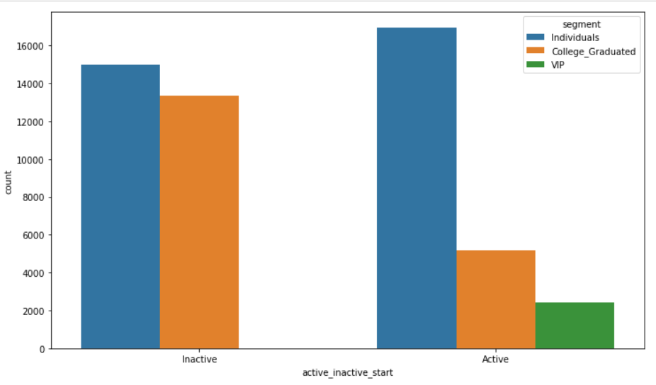
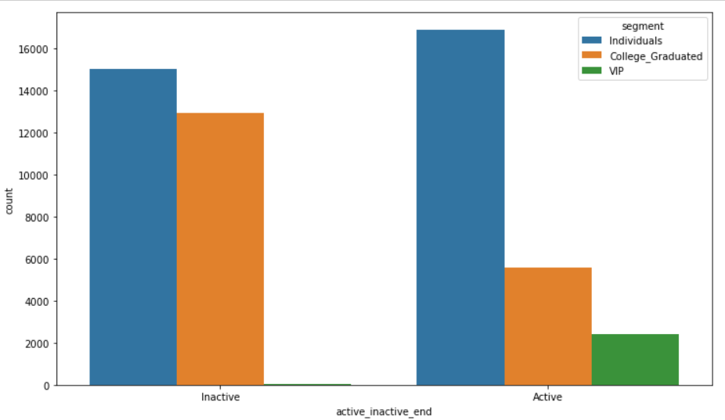
Bar Plot Analysis
The above graph shows the information about Active and Inactive customers during its starting period
The above graph shows the information about Active and Inactive customers during its end period

Slide 8
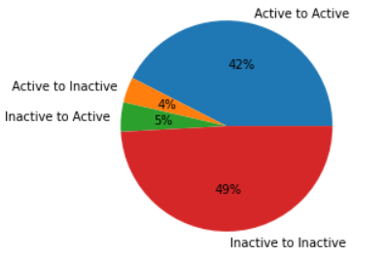
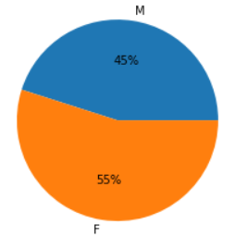
Analysis Results:
Start Period | End Period | No.of Customers | Percentage(%)
Active | Active | 22436 | 42.46
Active | Inactive | 2068 | 3.91
Inactive | Active | 2379 | 4.50
Inactive | Inactive | 25956 | 49.12

Slide 9
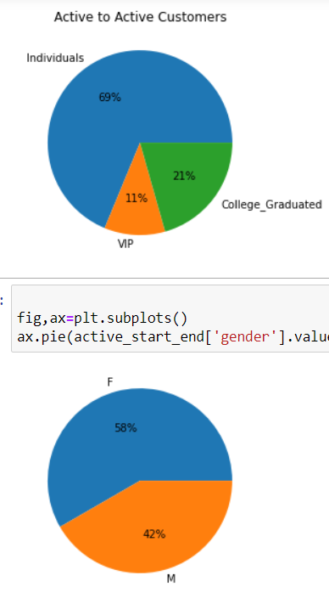
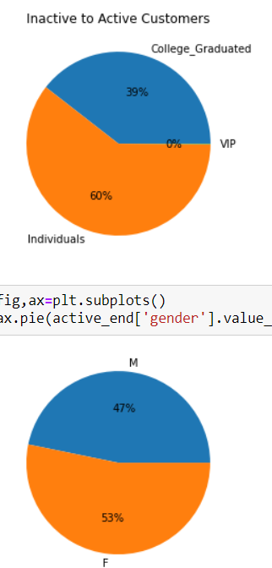
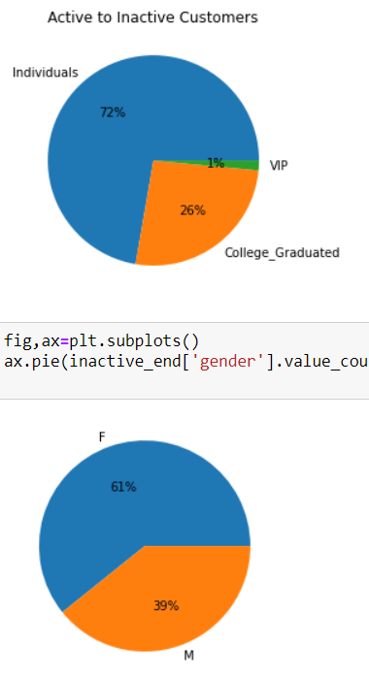

Slide 10
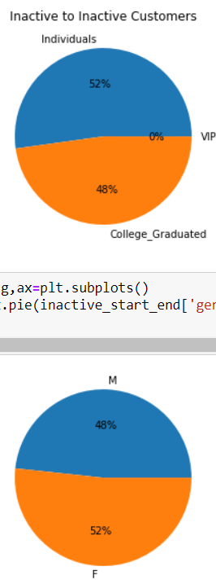
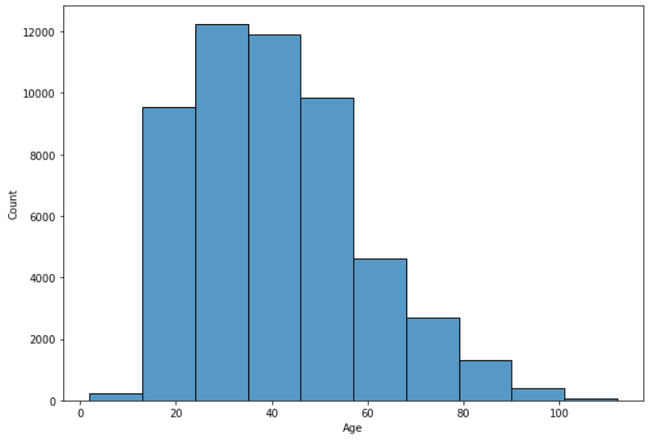
Individuals are more in all types of formats of active and inactive
Females have more number of percentage compared to male customers in all ascepts
There were more customers between the age 25 to 52 who were in active at the end of 6 months

Slide 11
Metric Based Analysis Results:
Average Gross Income is high for customers who remained in Active category.
Average Age is high for Active to Inactive category whereas it is least in Inactive to Inactive.
In the comparison between male and female in all the categories i.e, Gross Income, Age, Duration, Number of credit cards, Number of loans Female category is leading.
Among college graduates, individuals and VIP the average Gross Income is high for VIP whereas it is least for college graduates customers. College Graduates – Rs.115791
Individuals - Rs.141499
VIP - Rs.180192
Individuals remained active - 0.69%

Slide 12
Future Based Predictions on the given data
In future,Individuals can be expected to remain active compared to others as the raise of customers from Inactive to active is 60.4%
In future, College Graduates can be expected to remain inactive.
In future,Individuals can be expected to become active.
In future active customers are more at an age between 25 to 50 when compared to inactive customers.
In future, we must consider the gross income of the customer should satisfies the base gross income of the bank.

Slide 13
Key Takeaways and Recommendations
Key Takeaways from the Analysis :
The number of customers using credit card is very less(2695) when compared to the number of customers who are not using credit cards(51335).
From the analysis we have observed that the inactive customers are more when compared to
the active customers at the beginning.
At the end also the inactive customers are more when compared to the active customers.
The Male customers are less when compared to female customers.
In the segment Variable we have the three categories of people in that VIP’s having more Gross income , age, duration , number of credit cards , and number of loans.

Slide 14
Key Takeaways and Recommendations
Final Recommendations :
To increase the customers using the credit cards such aspects like decrease in rate of interest, Increase in advertising , providing better offers than the other banks should be
taken as the token of Priority.
Females has more percentage when they are converted from inactive to active state. So we
have to Concentrate more on females who are individuals and has an age in between 25
to 50 years.
Increase the credit limit of the customers who are maintaining a high average gross income.
Discounts can be a super powerful way to reactivate users because the customers who go through discounts has a lower willingness to pay.
Offering special promotions to former customers.

Slide 15


